Slide 1

Filled
Know
Love
Power

Slide 2
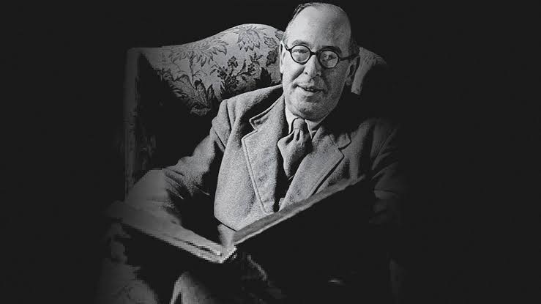
“In each of my friends there is something that only some other friend can fully bring out. By myself I am not large enough to call the whole man into activity; I want other lights than my own to show all his facets. Now that Charles is dead, I shall never again see Ronald’s [Tolkien’s] reaction to a specifically Charles joke. Far from having more of Ronald, having him “to myself” now that Charles is away, I have less of Ronald…In this, Friendship exhibits a glorious “nearness by resemblance” to heaven itself where the very multitude of the blessed (which no man can number) increases the fruition which each of us has of God.
For every soul, seeing Him in her own way, doubtless
communicates that unique vision to all the rest.
That, says an old author, is why the Seraphim in Isaiah’s
vision are crying “Holy, Holy, Holy” to one another
(Isaiah 6:3). The more we thus share the Heavenly Bread
between us, the more we shall have.” C S Lewis

Slide 3
Disciples
I am a follower of Jesus, who trusts in him alone for forgiveness of sin and my righteousness/acceptance before God.
I have a personal relationship with the Lord Jesus Christ, that I seek to nurture through regular prayer: praising, asking, confessing and thanking God.
I want to obey Jesus in every area of my life, and seek the Spirit’s ongoing transformation of my heart through regularly reading and meditating on God’s word, as the final authority for my faith and life.
I have been baptized to signify my union with Christ and my identification with his people

Slide 4
Family
I have a willingness to be in authentic and loving relationships with my brothers and sisters in Christ at Trinity, and commit to regularly attending both formal church gatherings and sharing in the informal family life of the church.
I submit to the spiritual authority of the Trinity church leadership, recognizing God has appointed them for my good. I commit to praying for them and seeking to make their work a joy and not a burden. I will diligently seek the unity and peace of Trinity, and endeavour to build others up with words of love and encouragement.

Slide 5
Missionaries
I desire to see the lives of others transformed through the Good News of Jesus Christ to the glory of God the Father by the power of the Holy Spirit.
Therefore I will be involved in lives of unbelievers, praying for them, loving them, and being willing to share my faith as the opportunity arises.
I will seek to live at peace with everyone, to love my enemies and through humble service, kindness and grace to commend the Gospel to those who reject it.

Slide 6
Servants
I will seek tangible ways to love and serve others both inside and outside the church. I will joyfully serve both generally for the good of the church and specifically in ways that fit my spiritual gifting.
I commit to faithful stewardship. To give generously, to remember the poor and to support the work of the Gospel at Trinity and in the wider kingdom of God.

