Slide 2
“HOPE IN GOD
1. Hope longs for the Living God
2. Hope looks through tears
3. Hope remembers God’s love
4. Hope looks to God’s Salvation

Slide 3
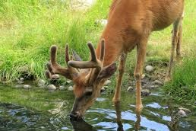
1. Hope Longs for the Living God
Psalm 42 : 1, 2

Slide 4
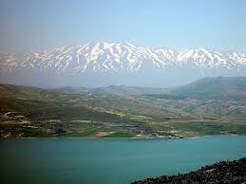
Psalm 42 : 6
Lake Galilee with Mt Hermon in background

Slide 5

2. Hope looks through tears
Psalm 42 : 3

Slide 6

“Why are you cast down, O my soul, and why are you in turmoil within me?”
Psalm 42:5

Slide 7
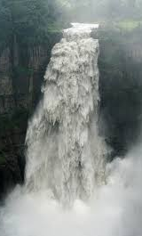
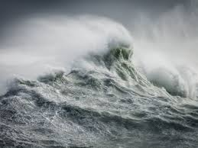
Psalm 42 : 7

Slide 8
3. Hope remembers God and His Love

Slide 9
Psalm 42 : 8

Slide 10
Why are you cast down, O my soul, and why are you in turmoil within me?
Hope in God; for I shall again praise Him,
my salvation and my God.
Psalm 42:5,11

Slide 11
4. Hope looks to God’s Salvation
Hope in God; for I shall again praise Him,
my salvation and my God.
Psalm 42:5,11

