Slide 1
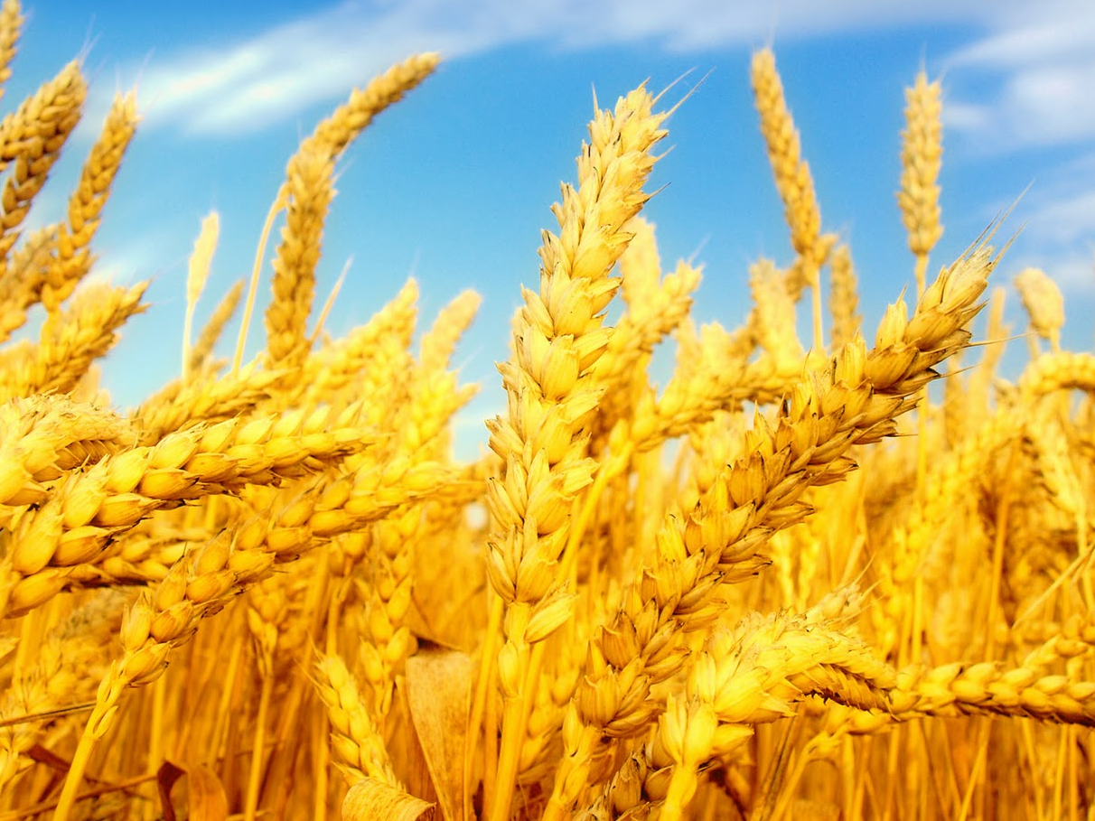
Believing In and Praying To the Lord of the Harvest
Luke 10:1-16

