Slide 1
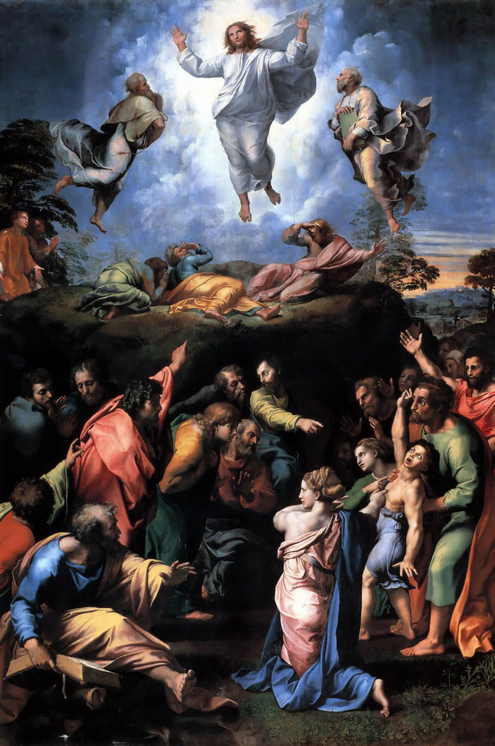
Trust God to Do what Only God Can Do
Five Things to Learn: #1

Slide 2
Trust God to do what only He can do for yourself and others
Luke 9:37-43

