Slide 1
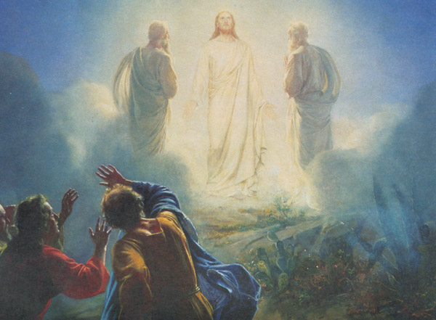
Jesus Transfigured: A taste of something better
Luke 9:28-36

