Slide 1
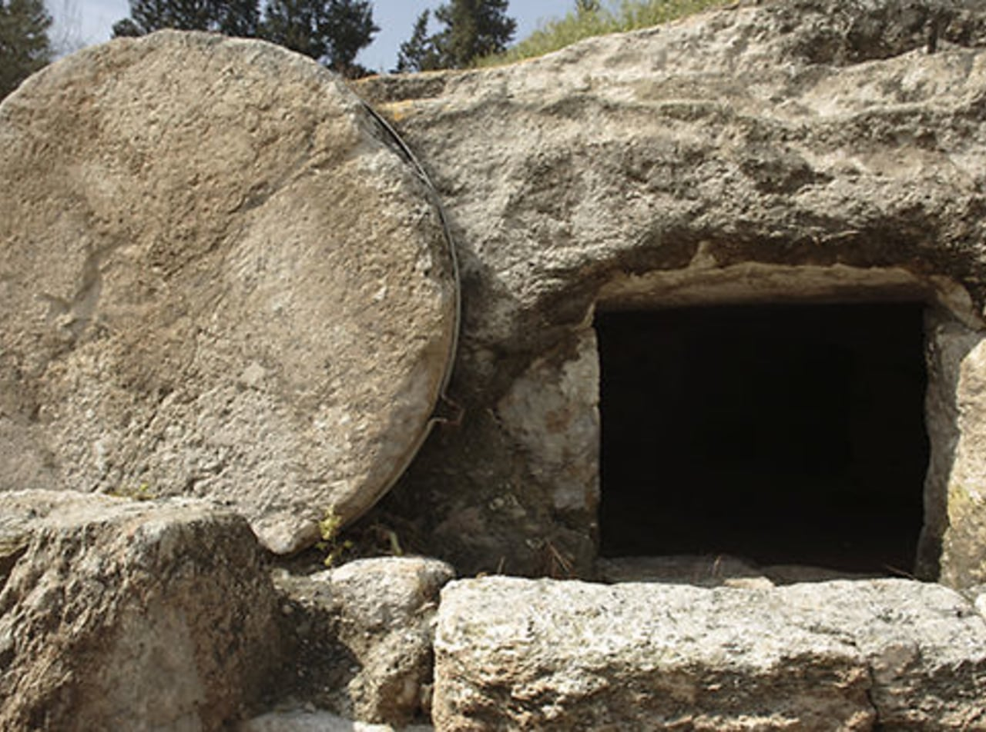
Jesus is Not in the Tomb
Luke 24:1-12

