Slide 1
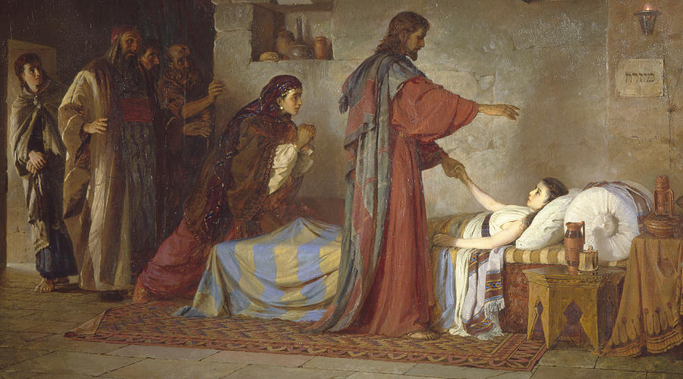
Faith in Jesus the Lord of Life and Death
Luke 8:40-56

Slide 2
Luke 8:40-56
Faith in Jesus when death is certain and he offers life

