Slide 1
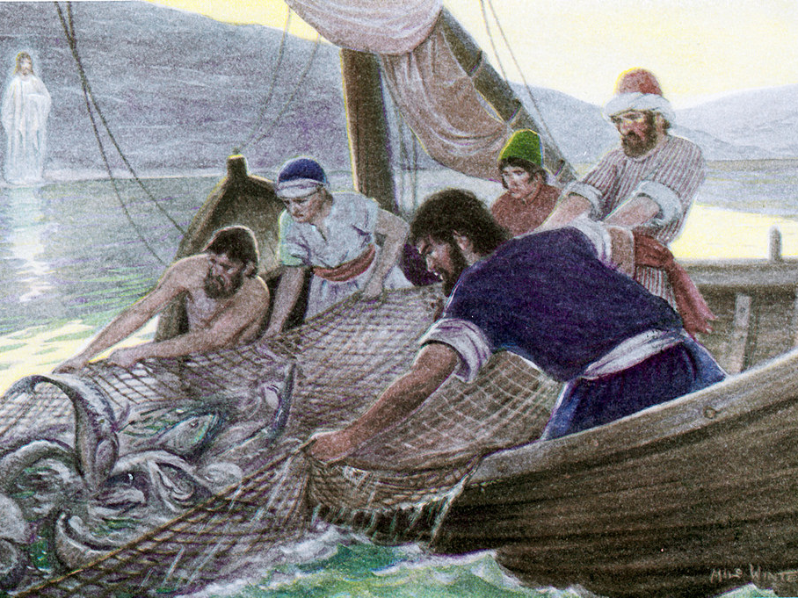
Faith & Following
Luke 5:1-11
This Photo by Unknown Author is licensed under CC BY

Slide 2

Luke 5:1-11
Jesus teaching by Lake Gennesaret (Galilee) from a boat
Asks Simon (Peter) to launch out and fish
Caught so many nets breaking and boats sinking
“Depart from me Lord”
“From now on you will catch men”
They left everything and followed him

Slide 3
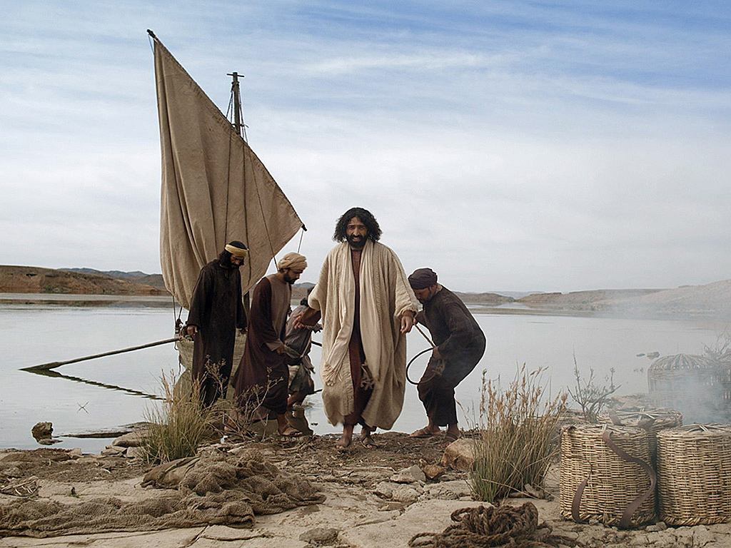
Luke 5:1-11
Meeting Jesus by Faith
Following Jesus by Faith

