Slide 1
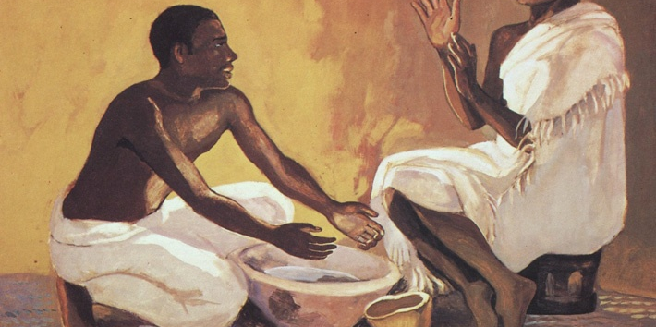
The Love that Demonstrates Truth
John 3:34,35

Slide 2
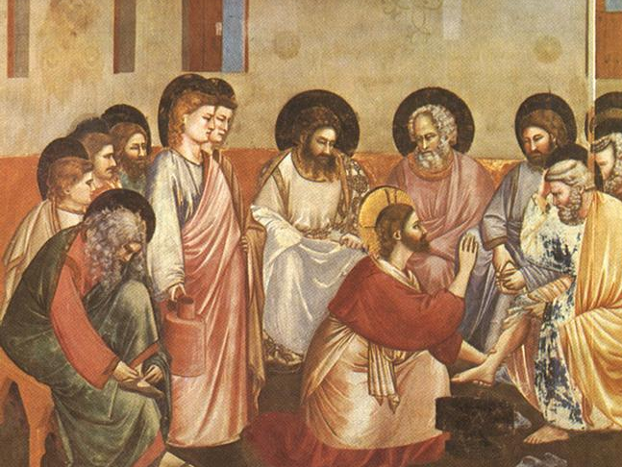
John 3:34,35
Jesus commands us to love each other like he loves us
Our ‘Jesus love’ shows the truth of our faith

