Slide 1
John’s Birth Announced: God’s big story continues
Luke 1:5-25

Slide 2
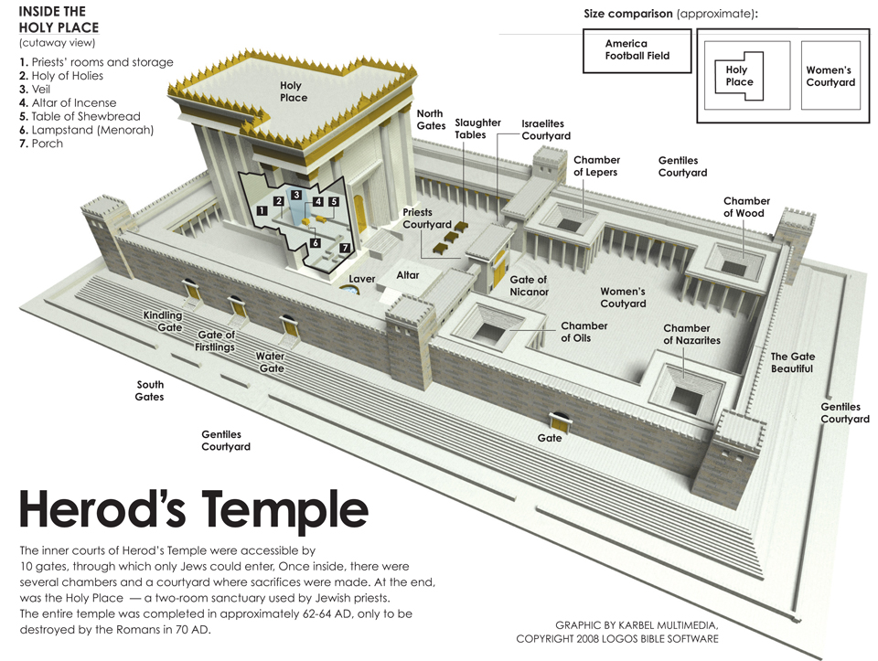

Slide 3


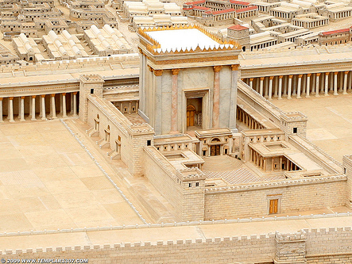

The scene
z
Zechariah
Elizabeth
Gabriel
John

Slide 4
Are you in God’s story of salvation?
1. You are in God’s one big story of salvation
2. God’s story asks you for faith
3. It is a story that promises you hope
This Photo by Unknown Author is licensed under CC BY

