Slide 1

Being Certain of Your Faith
Luke 1:1-4

Slide 2
Uncertainty
Everyone has questions
Some have doubts

Slide 3

What causes questions and doubts?
This Photo by Unknown Author is licensed under CC BY

Slide 4
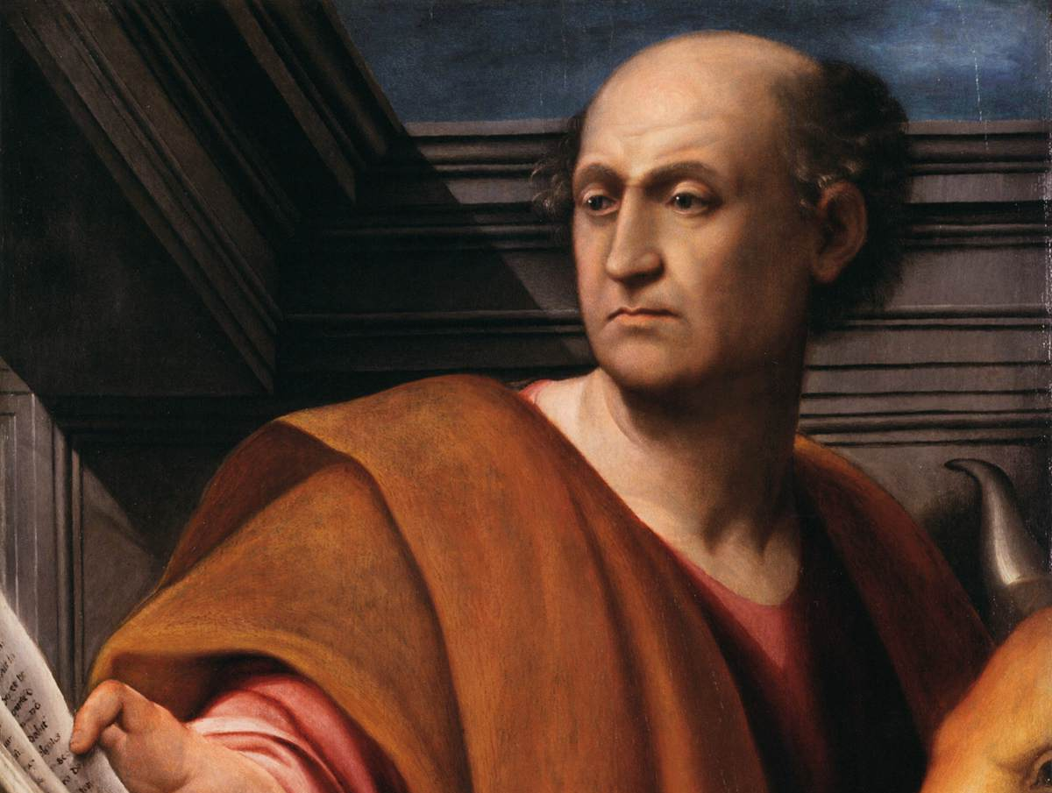
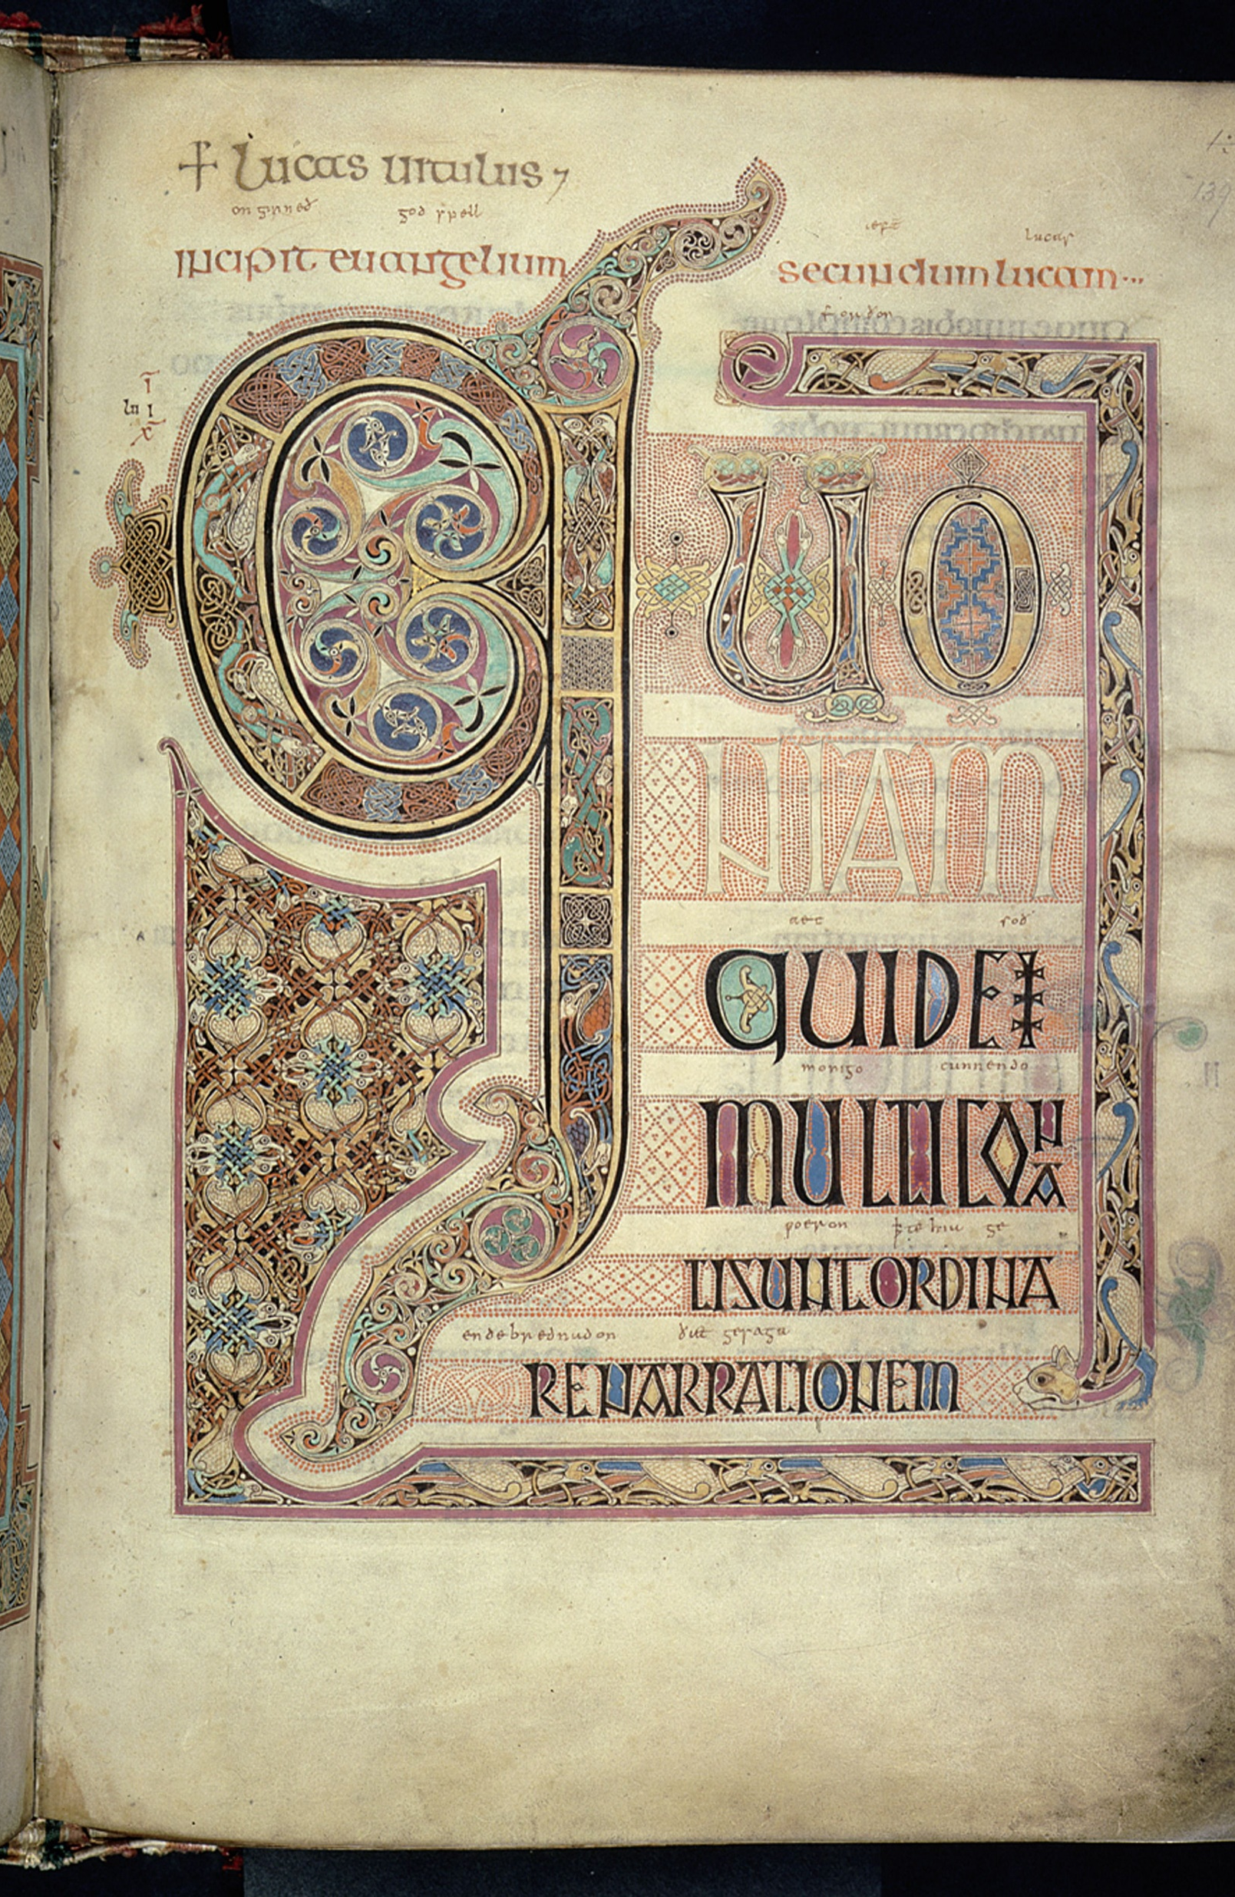
The Gospel According to Luke

Slide 5
Luke 1:1-4
You can trust the Bible
You Should trust the Bible

