Slide 1
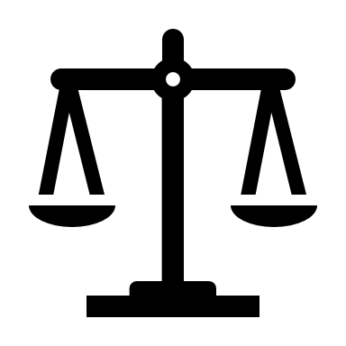
The Final Judgment
‘I believe (that) … from thence (heaven) Jesus will come to judge the living and the dead.’

Slide 2
Matthew 25 – Teaching the judgment
The parable of the ten bridesmaids and the wedding (1-13)
The parable of the three servants given money by their master (14-30)
The day of judgment described (31-46)

Slide 3
Matthew 25:31-46
Jesus is the only Judge
Everyone is judged
Everyone is judged according to the evidence

Slide 4

A warning of justice and encouragement to trust in Christ

