Slide 1
The Heart of the Gospel
Acts 26

Slide 2


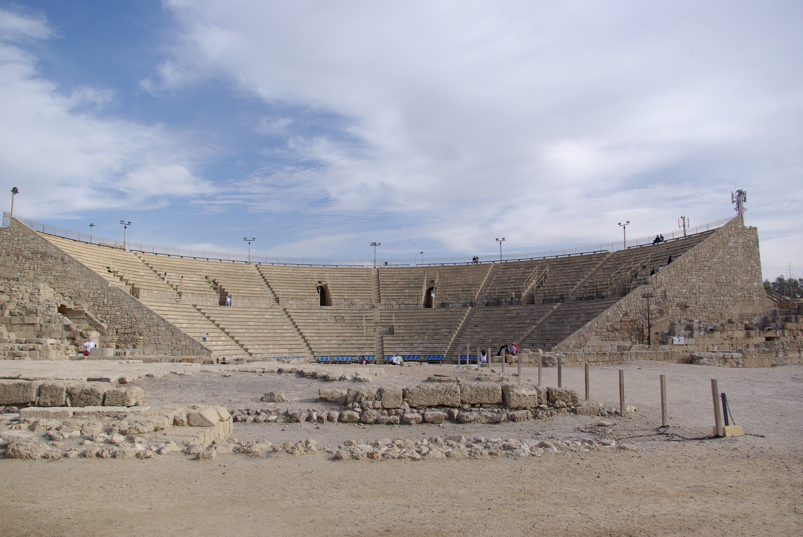
This Photo by Unknown Author is licensed under CC BY-SA

Slide 3
The heart of the gospel
Open your eyes to see God

Slide 4
The heart of the gospel
Open your eyes to see God
Repent to receive forgiveness and a place with God

Slide 5
The heart of the gospel
Open your eyes to see God
Repent to receive forgiveness and a place with God
take the gospel seriously

