Slide 1
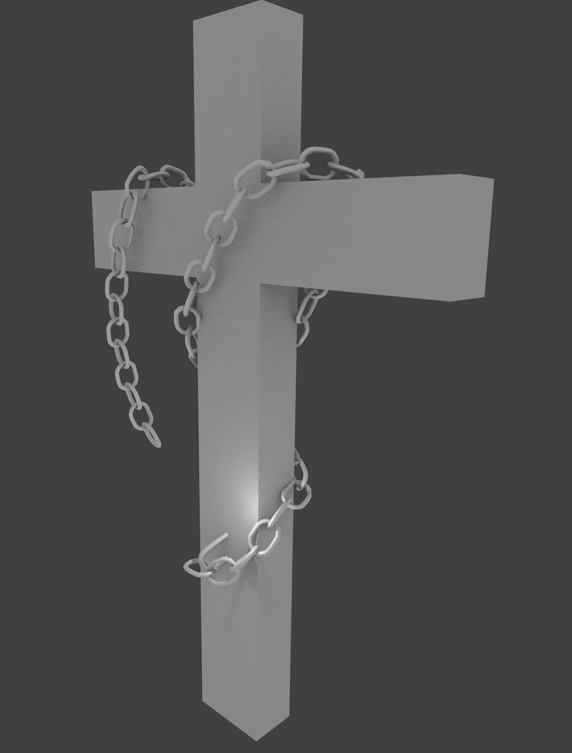
Would You Feel Privileged to Suffer for Jesus?
Acts 5:12-42

Slide 2
Just because you are experiencing pain and trouble does not mean that God doesn’t love you. In fact, the very opposite is most probably true!
We experience times of amazing power in the faith
Which often come with incredible suffering for Jesus

