Slide 1

Without Love We are Lost
First Corinthians Thirteen

Slide 2


Without love we are lost…
We focus on gifts
The church at Corinth did too
We can be gifted but loveless

Slide 3

1. Why you need love: without love a Christian is nothing (1-3)
Without love our spiritual gifts are worthless
Without love our best deeds are meaningless

Slide 4
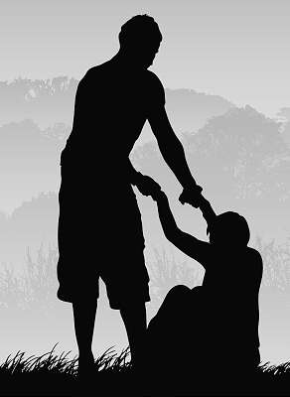
2. What Love looks like: practical self-denying Christ-likeness (4-7)
What love does NOT look like
What love Does look like

Slide 5

3. Love lasts: the comprehensive perfection of love (8-13)
Everything passes away
Love remains

