Slide 1
Different & Dependent
Diversity & Interdependence in the church

Slide 2

1 Corinthians 12.12-31

Slide 3
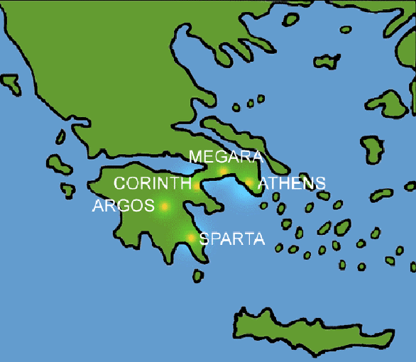
Background: Corinth, Greece
Letter to answer questions
Each has different gifts/ God-given abilities
Gifts are for the whole church (12.7)
Church is like a ‘body’ (the Body of Christ) that we are all part of through baptism (12-14)

Slide 4

1. Diversity: we’re all different in the church
Like the body (arms, legs etc.)
Not one organ (eye, ear) (17)
Only one organ = no body (19)
We need to embrace our differences (15-16)
We are not all expected to have the same gifts (28-31)

Slide 5

2. Dependence: we all need each other in the church
Like the body, we can’t say we don’t need others (21)
‘inter-dependence’
Even the ‘less presentable’ parts of the body (22-24)
We all need each other (25-26)
We can’t divide the body of Christ or form groups

Slide 6
Conclusion:
All different, but we need each other
Something to be desired
The ‘Body of Christ’ belongs to Jesus, but you are part of it

