Slide 1

The Gospel According to ANZAC Day
Galatians 1.1-5

Slide 2
ANZAC DAY
25th April, 2015 = 100 years
Should Christians talk about it?
A good opening for the good news about Jesus

Slide 3

1. We live in peace by God’s grace (v.3)
Peace from God
Peace as a free gift (grace)
Peace on the inside

Slide 4

2. Peace comes from Jesus sacrifice for us (4)
NZ soldiers sacrificed themselves for their families and nation.
Jesus sacrificed himself for sinners.
He came as a servant.
1 Peter 3:18.

Slide 5
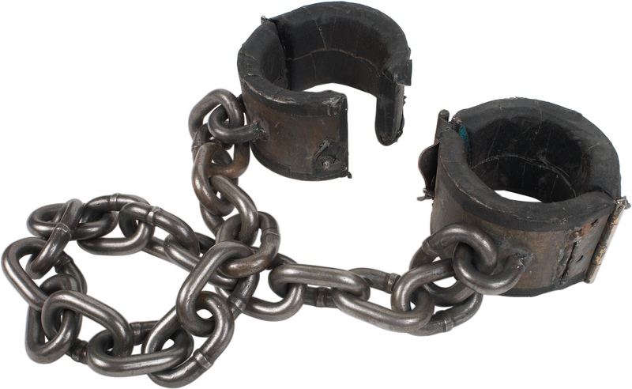
3. His sacrifice rescues us from evil rule (4)
Just wars are about overcoming evil.
The gospel is about overcoming spiritual evil.
Jesus came to deliver us the present evil.
Colossians 1.13-14.

Slide 6

4. According to God’s plan and for his glory (5)
WWII plans
The Gospel is God’s plan.
Verse 4
Ephesians 1.11
For God’s glory.

Slide 7
ANZAC DAY
Honour those who died or risked their lives for our peace,
But…
Glorify God for his plan to give us peace through the sacrifice of his only Son who rescued you from evil

