Slide 1
Sharing your faith: 3
Sharing with mormons

Slide 2
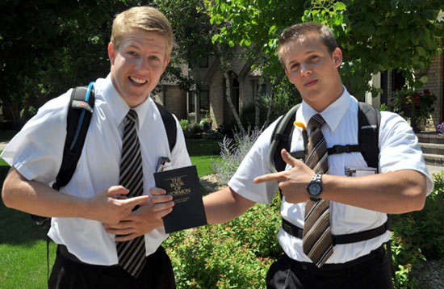
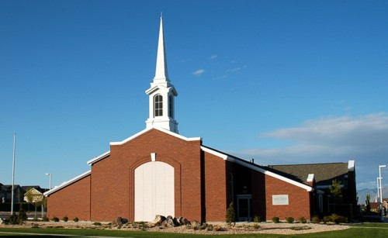
introduction

Slide 3
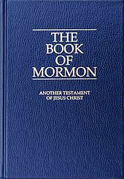
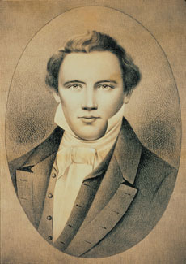
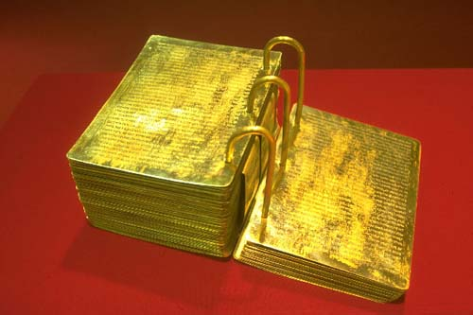
History

Slide 4
Central Mormon beliefs
The great apostasy
The restoration
God – three of them biologically related
The temple
Salvation – general & immortal

Slide 5

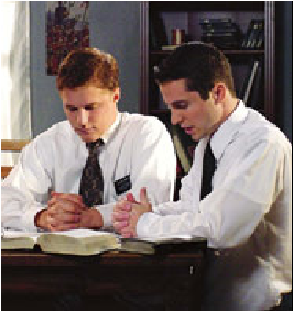
Mormon missionaries
Purpose to invite people to accept ‘restored gospel’
The ‘restored gospel’ is the only way to be saved
they have authority over others
The BOM is evidence joseph smith was a prophet
Show their love for god by bringing souls to him
Success = obedience, righteousness, helping others

Slide 6
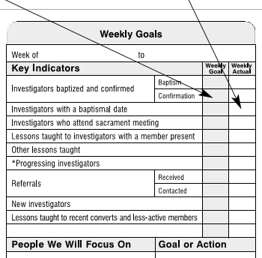
Visiting Targets/ performance

Slide 7
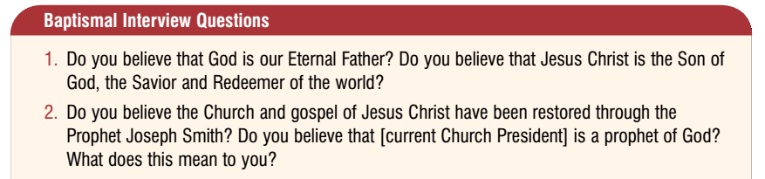
Mormons are not Christians

Slide 8

Share your faith: Ephesians

Slide 9

1. Know what the bible says

Slide 10
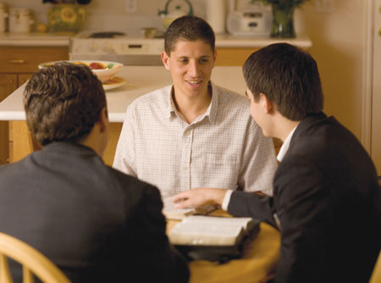
2. Find a place to talk

Slide 11

3.Share your faith

Slide 12
conclusion
You can Share your faith with mormons

