Slide 1
John 15:18-27
Hated by the world

Slide 2


John 15:18-27
What’s your choice?

Slide 3
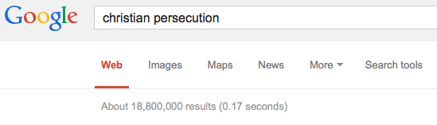
John 15:18-27
If the world hates you … (v18)
Jesus was hated
His first followers were hated
His followers today are hated
Death
Exclusion and ostracism
Legal harassment
…

Slide 4
John 15:18-27
Hated because of … (v18-21)
Being different can draw dislike
To follow Jesus is to be very different
… in where we belong
… in whose we are
- Aliens, strangers and outsiders
… on account of my name … (v21 & 1 Pet 4:16)
Ensure that Jesus is the only offense we give

Slide 5
John 15:18-27
Hated against reason… (v22-24)
Jesus spoke clearly and backed it up with his deeds, but ears and eyes were closed because of hard hearts
The real issue
Competing loyalties and life-views
So don’t get mad or even get even
love and pray for the person
stand your ground

Slide 6
John 15:18-27
Hated cannot have the last word … (v26-27)
The danger of dismay (16:1-4)
The mission must go on
The Spirit would be sent and do his work
But God’s people must be the Spirit’s voice
We must speak
who else is there?
despite the cost
this is our mission
because God speaks through us

Slide 7
John 15:18-27
Hated cannot have the last word … (v26-27)
The challenge
to remain in Jesus
to remain in the world
to love those who hate us
to speak for Jesus
For reflection
Where am I silent because I hate being hated?
How can I break my silence?

Slide 8
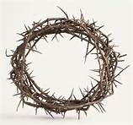
John 15:18-27
What will I do as the if becomes when? (v18)

